Slide 1
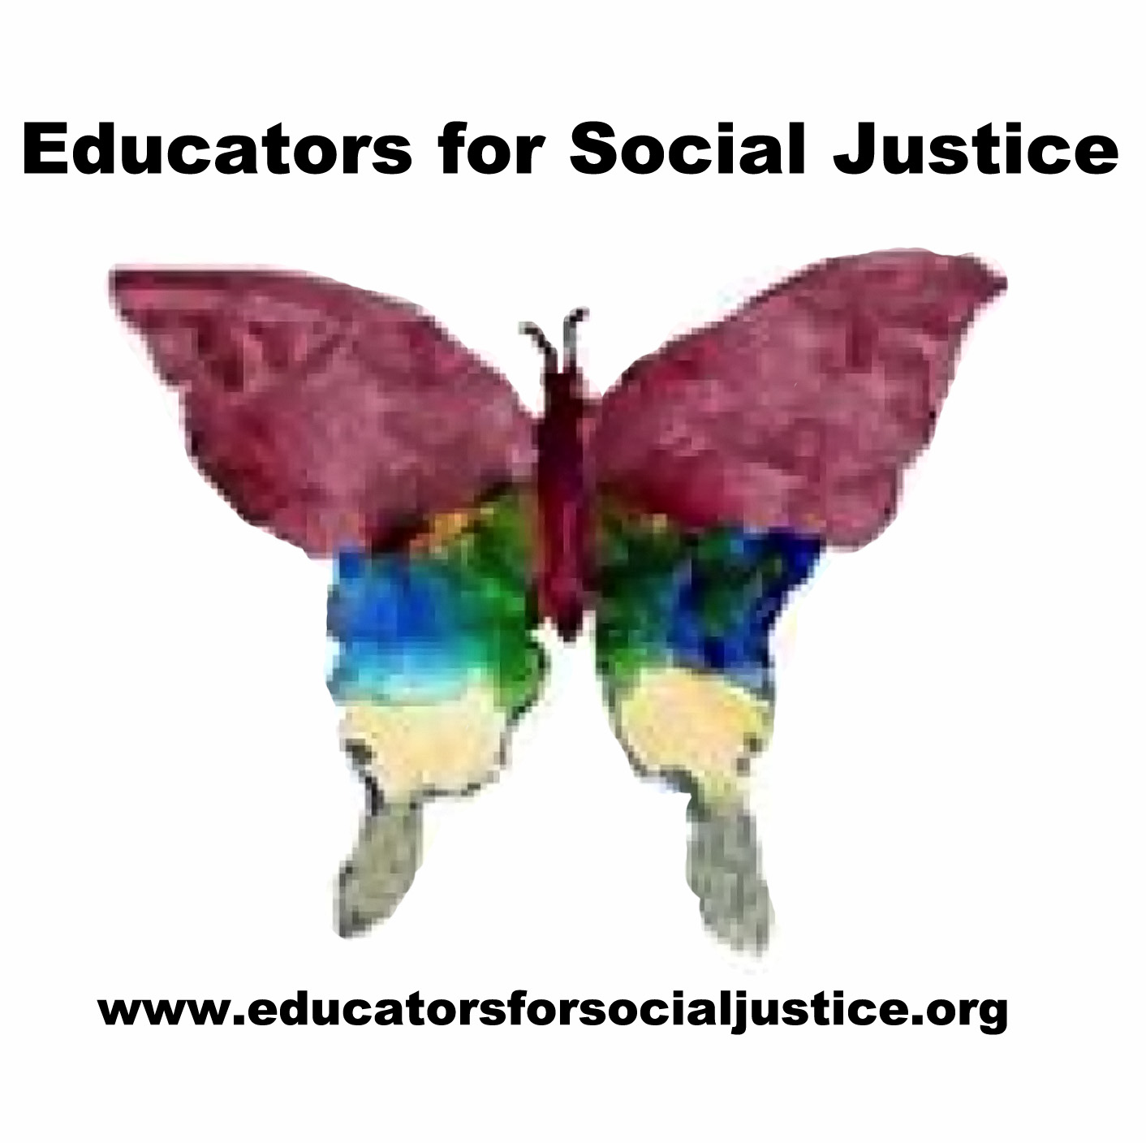
EDUCATORS FOR SOCIAL JUSTICE
www.educatorsforsocialjustice.org

Slide 2
Mission
Educators for Social Justice (ESJ) is a grassroots, teacher-led professional development group located in St. Louis, MO. We believe that educators are public intellectuals who gain strength and wisdom through working with other educators, parents and members of the community. Our mission is to develop and support socially just, equitable, and sustainable practices in schools and communities. We are committed to connecting educators across the lifespan and building networks to mobilize resources to promote progressive change. We want to promote the idea that developing socially just curriculum is a form of activism.

Slide 3
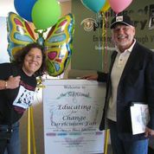
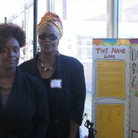
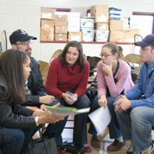
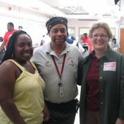

Slide 4
Ongoing Events
Inquiry to Action Groups (ItAGs)
An ItAG is an Inquiry to Action Group. It is similar to a study group that comes together around a social justice issue or topic. ItAGS are usually small groups of educators, parents, students, activists, teaching artists, and community members. The goal of the ItAGs is to pursue a common inquiry on a social justice topic and create an action around this area of study. The group decides the focus and structure of the meetings.

Slide 5
Ongoing Events
Book Clubs
We meet on the 2nd Tuesday (every other month) from 5:00-6:00pm at various locations to discuss books related to social justice & education.
Film Screenings
Co-sponsored events
Throughout the year, ESJ co-sponsors events related to education and social justice. Recently, we co-sponsored a workshop at “holding courageous conversations” at the MO History Museum.
Courageous Educator Award
Each year, ESJ solicits nominations for the annual Courageous Educator Award to be announced at the conference. www.educatorsforsocialjustice.com

Slide 6
Needs funds for your social justice initiative? Apply for the ESJ Grant!
The Educators for Social Justice Grant of $300 will be given annually to a social justice educator. The grant will be used to support an educator-led initiative with an explicit social justice emphasis. The initiative may be classroom, school, or community based (e.g. a unit on environmental racism, supporting youth-led radio, art-based activism, a book study on peace education, etc.).
The grant is inspired by the work of Mary Ann Kramer, one of the founders of ESJ (formerly known as the Literacy for Social Justice Teacher Research Group). She is a longtime civil and educational rights activist. She has provided vision to many groups and organizations working for peace, women's rights, and educational rights.
Proposals are due May 1. Apply today! www.educatorsforsocialjustice.org

Slide 7
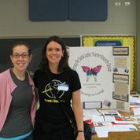
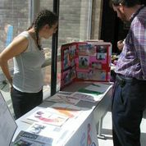
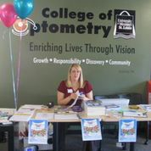
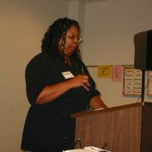

Slide 8
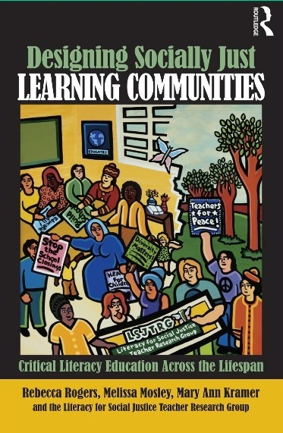
Research and Media Attention
The Literacy for Social Justice Teacher Research Group (2005). The Long Haul: Professional Development as Social Change. Language Arts, 82(5), 347-358.

Slide 9
A Retrospective Look at Ten Years of Educating for Change
1st Annual Educating for Change Curriculum Fair, May 14, 2005
Featured Speakers: Bob Peterson, Rethinking Schools & Kenya Ajanku, Africa Alive
2nd Annual Educating for Change Curriculum Fair, September 30, 2006
“Immigrant and Refugee Rights in the Context of Racial Justice”
Featured Speaker: Jesus Macarena-Avila, Chicago based artist and activist
3rd Annual Educating for Change Curriculum Fair, September 29, 2007
“Peace Education”
Featured Speakers: Parkway Peace High School, Philadelphia

Slide 10
4th Annual Educating for Change Curriculum Fair, September 27, 2008
“Defining Democracy”
Featured Speaker: Dr. Kevin Kumashiro, Center for Anti-Oppressive Education
5th Annual Educating for Change Curriculum Fair, September 29, 2009
“Claiming Education as a Civil Right”
Featured Speaker: Jill Friedberg, documentarian
6th Annual Educating for Change Curriculum Fair, October 9, 2010
“Educating for Community Empowerment”
Featured Speakers: Mia Henry and Asucena López, Chicago Freedom School

Slide 11
7th Annual Educating for Change Curriculum Fair, October 8, 2011
“Creating Spaces for Social Justice in an Era of Standardized Testing”
Featured Speaker: Deborah Meier, educational reformer, writer and activist
8th Annual Educating for Change Curriculum Fair, March 2, 2013
“Partnering for Social Justice”
Featured Speakers: Bread and Roses, Growing American Youth, Beyond Housing, 24:1 Initiative,
and EarthDance Farm
9th Annual Educating for Change Curriculum Conference, February 22, 2014
“Race, Class & Education in St. Louis”
Featured Speakers: Sr. Antona Ebo, Ian Buchanan, Rob Good, Amy Hunter, Phil Hunsberger, Deborah Nelson-Linck, Kwame Mensah and Naomi Warren

Slide 12
10th Annual Educating for Change Curriculum Conference, February 7, 2015
“Empowering Diverse Learners”
Featured Speakers: Dr. June Christian, Mr. Vince Estrada, Dr. Charlotte Ijei, Dr. Charles Pearson, Ms. Stephanie Roberson, and Dr. Nancy Williams

Slide 13
Interested in becoming more involved with ESJ?
Participate in or propose an Inquiry to Action Group
Volunteer to help (e.g. fundraising, website development, curating of social justice materials)
Become a “social justice curriculum partner”
Donate funds
Join the Conference planning committee

